Slide 1
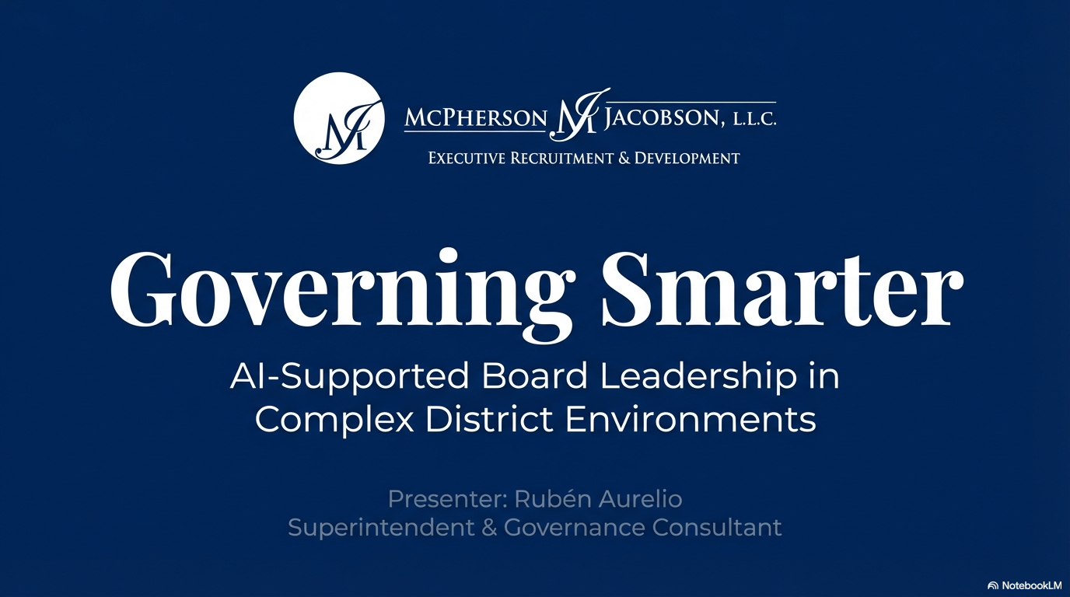
Notes:
Good evening and thank you for joining today’s session.
My name is Rubén Aurelio, and I’m honored to be with you as part of the McPherson & Jacobson consulting network.
Today’s conversation is not about artificial intelligence as a trend.
It’s about governance.
Specifically, how structured AI tools can strengthen board preparation, alignment, and public trust — without replacing judgment.
AI informs. Boards decide.
That principle anchors everything we’ll discuss.

Slide 2
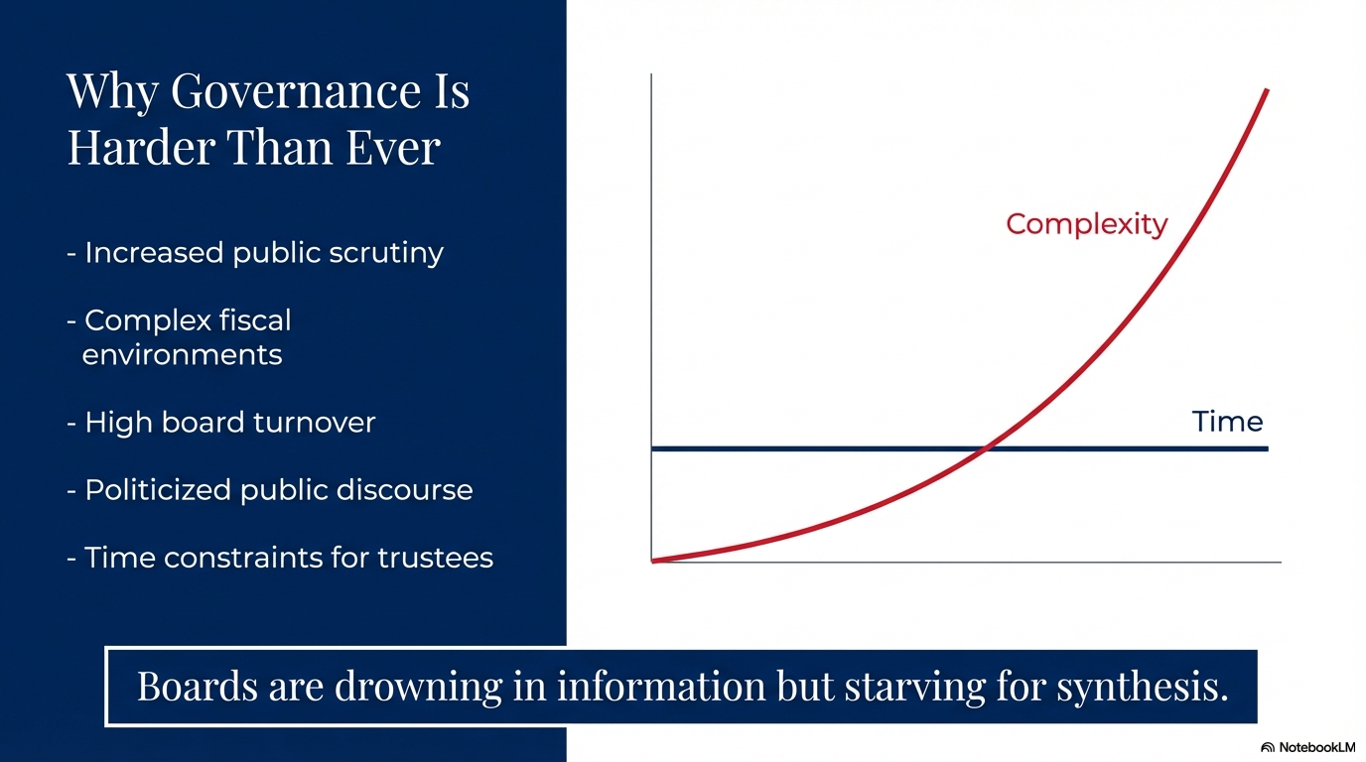
Notes:
Let’s start with reality.
Governance is harder than it has ever been.
Public scrutiny is higher.
Fiscal complexity is increasing.
Board turnover is common.
Political discourse is more intense.
And trustees are serving part-time in full-time complexity.
The challenge today isn’t lack of information.
It’s lack of synthesis.
Boards are drowning in documents, data, and public commentary — but often starving for structured alignment.
That’s where disciplined AI support becomes relevant.

Slide 3
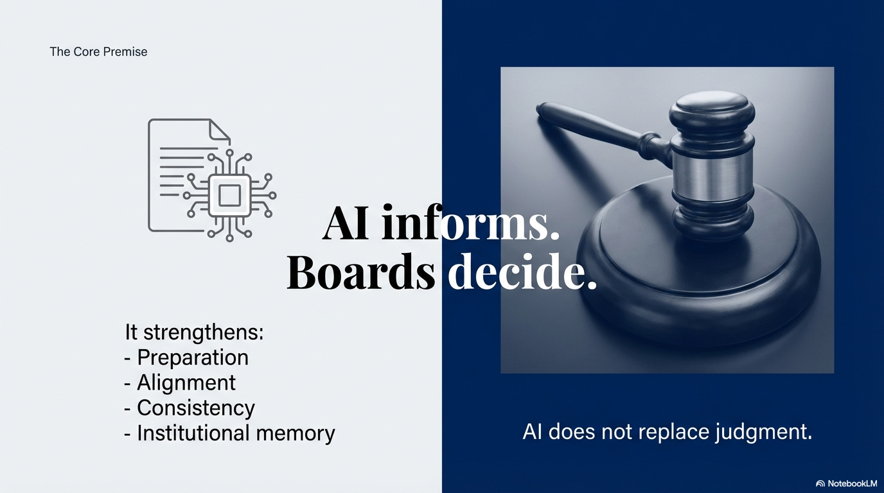
Notes:
Let’s be very clear.
AI does not deliberate.
AI does not vote.
AI does not replace human judgment.
What it can do is organize information, align documents, and surface connections faster than manual searching.
When used properly, it strengthens preparation and reduces drift.
This is about governance discipline — not automation.

