Slide 1
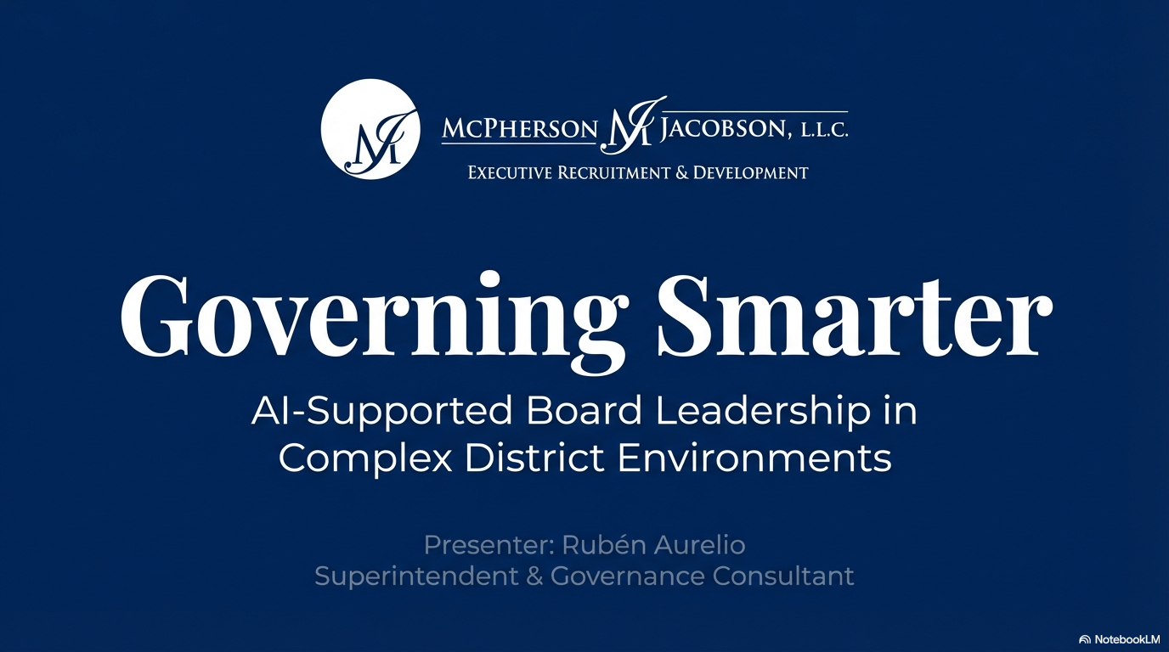
Notes:
Good evening and thank you for joining today’s session.
My name is Rubén Aurelio, and I’m honored to be with you as part of the McPherson & Jacobson consulting network.
Today’s conversation is not about artificial intelligence as a trend.
It’s about governance.
Specifically, how structured AI tools can strengthen board preparation, alignment, and public trust — without replacing judgment.
AI informs. Boards decide.
That principle anchors everything we’ll discuss.

Slide 2
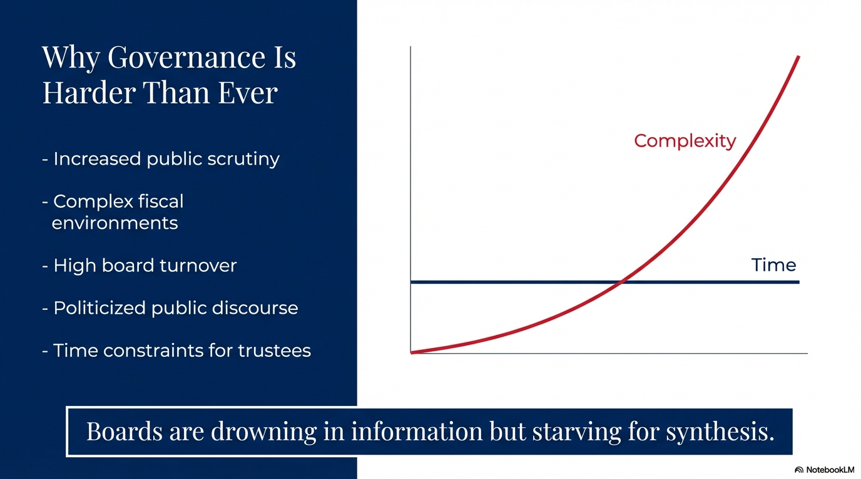
Notes:
Let’s start with reality.
Governance is harder than it has ever been.
Public scrutiny is higher.
Fiscal complexity is increasing.
Board turnover is common.
Political discourse is more intense.
And trustees are serving part-time in full-time complexity.
The challenge today isn’t lack of information.
It’s lack of synthesis.
Boards are drowning in documents, data, and public commentary — but often starving for structured alignment.
That’s where disciplined AI support becomes relevant.

Slide 3
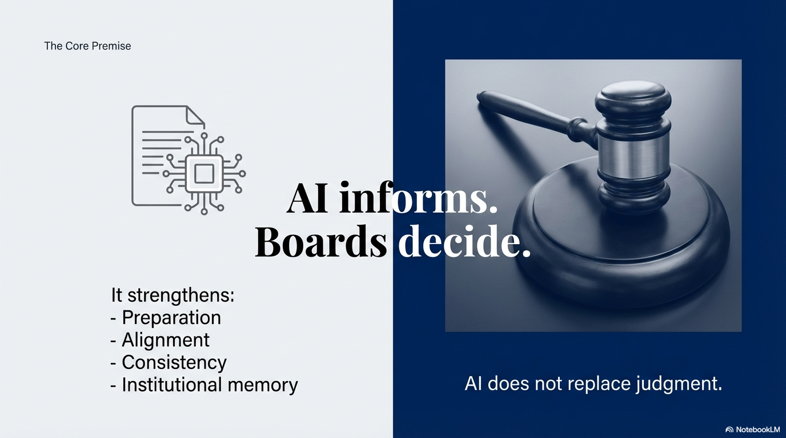
Notes:
Let’s be very clear.
AI does not deliberate.
AI does not vote.
AI does not replace human judgment.
What it can do is organize information, align documents, and surface connections faster than manual searching.
When used properly, it strengthens preparation and reduces drift.
This is about governance discipline — not automation.

Slide 4
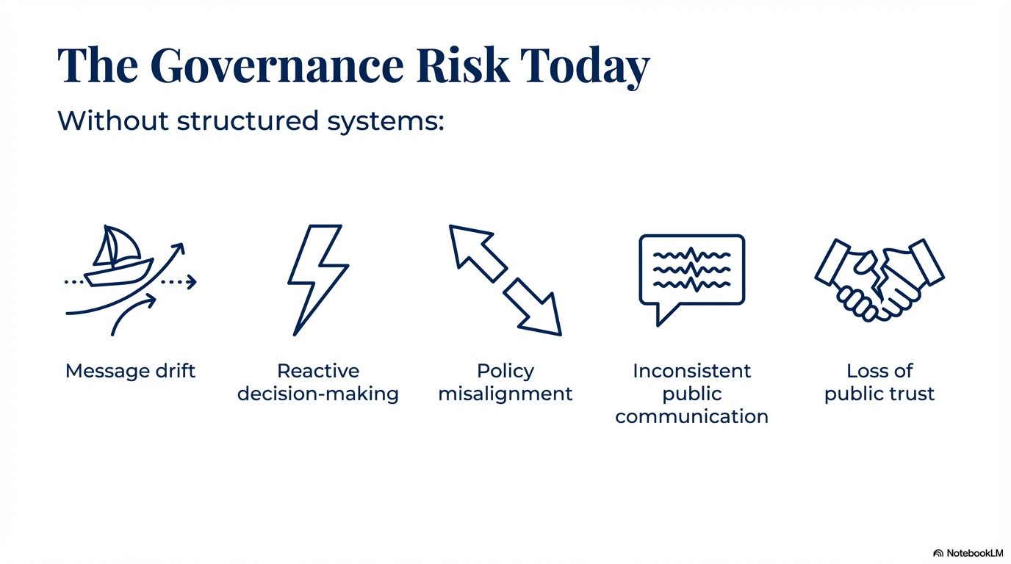
Notes:
Without structured systems, boards face predictable risks:
Message drift.
Reactive decisions.
Policy misalignment.
Inconsistent public communication.
And ultimately, erosion of public trust.
None of those are technology failures.
They are alignment failures.
AI, when structured around adopted board documents, helps reduce those risks.
But only if used intentionally.

Slide 5
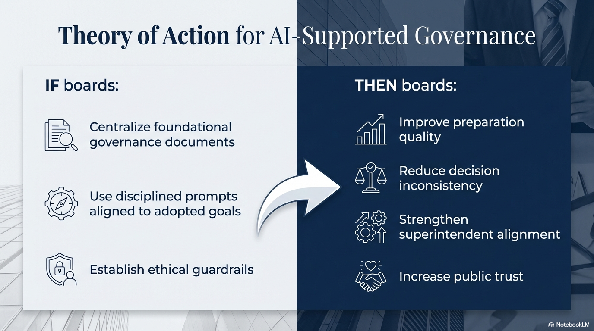
Notes:
Here’s the governance theory of action.
If boards centralize foundational documents into a structured AI research environment…
If they use disciplined prompts aligned to adopted goals…
And if they establish ethical guardrails…
Then preparation improves.
Alignment strengthens.
Public communication becomes more consistent.
And trust increases.
The technology is secondary.
The governance discipline is primary.

Slide 6
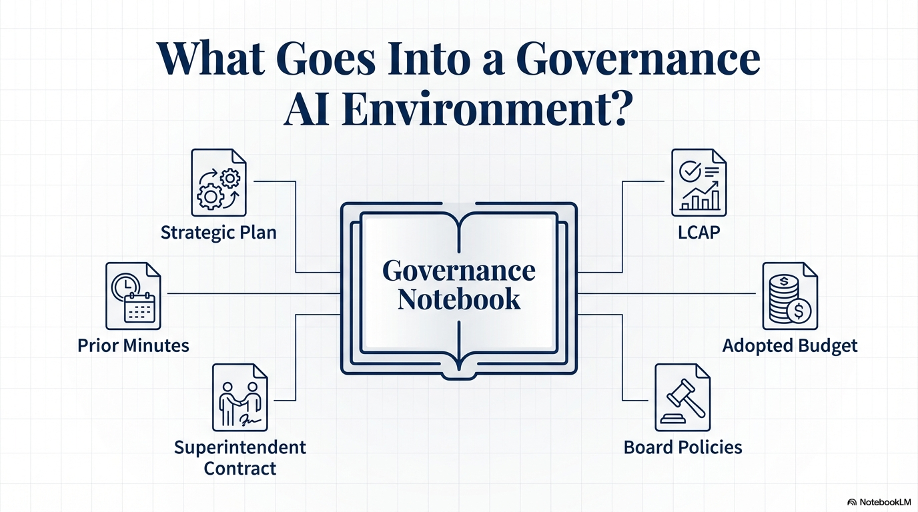
Notes:
This is important.
We are not uploading random information.
A governance notebook includes documents the board has already adopted:
Strategic Plan
LCAP
Budget
Board Policies
Superintendent Contract
Prior Minutes
These are already public governance documents.
AI simply makes them searchable and cross-referenced efficiently.
It becomes a structured governance archive.

Slide 7
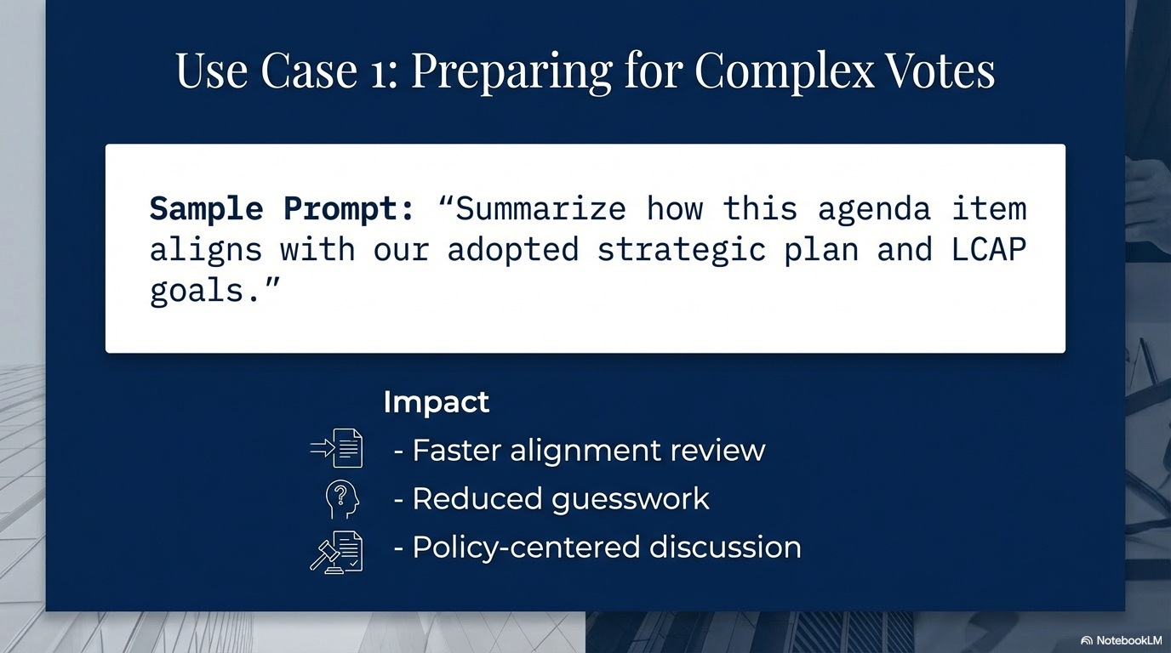
Notes:
Before a complex vote, trustees often ask:
How does this align with our adopted goals?
Instead of manually flipping through documents, a trustee can ask:
“Summarize how this agenda item aligns with our strategic plan and LCAP.”
The result is faster clarity.
This does not tell you how to vote.
It anchors the discussion in adopted priorities.
That’s governance discipline.

Slide 8
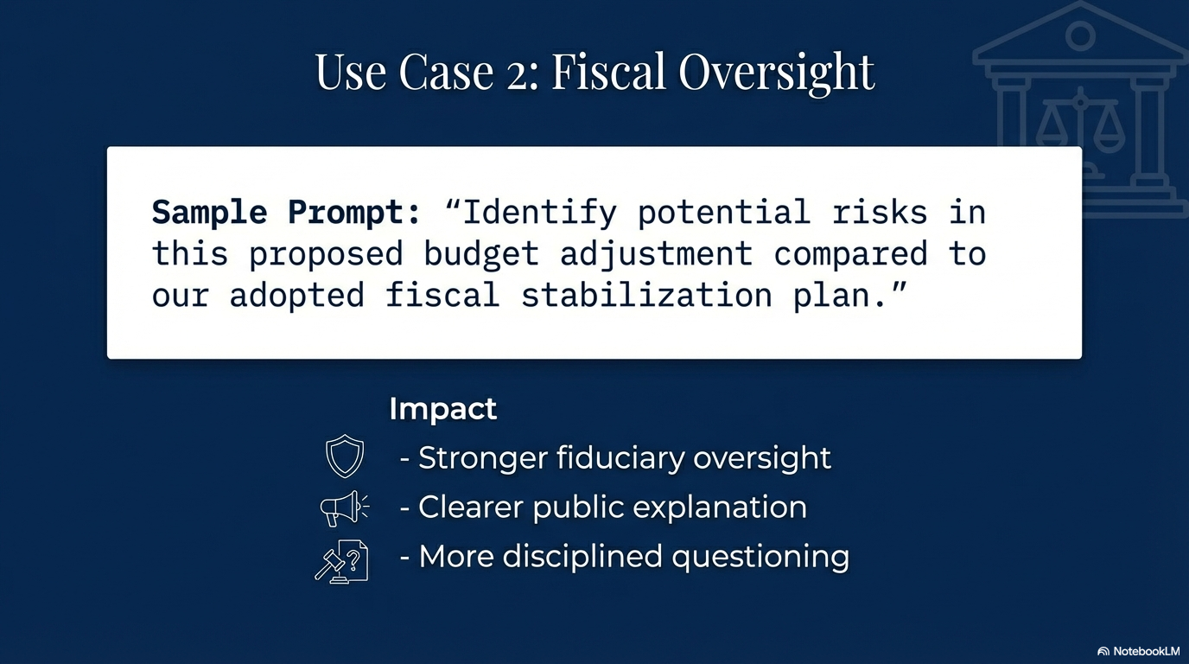
Notes:
Boards carry fiduciary responsibility.
You can prompt:
“Identify potential risks in this proposed budget adjustment compared to our adopted fiscal stabilization plan.”
This helps trustees prepare stronger oversight questions.
It does not replace staff analysis.
It strengthens trustee preparation.

Slide 9
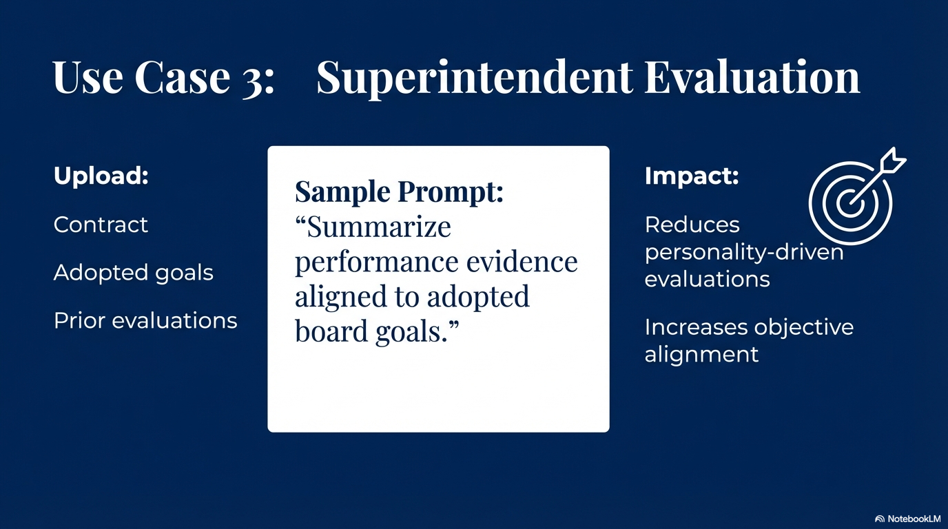
Notes:
Evaluation can drift into personality-driven discussions.
When the contract, goals, and prior evaluations are centralized, trustees can ask:
“Summarize performance evidence aligned to adopted board goals.”
That keeps evaluation objective and policy-centered.
This strengthens superintendent-board alignment.

Slide 10
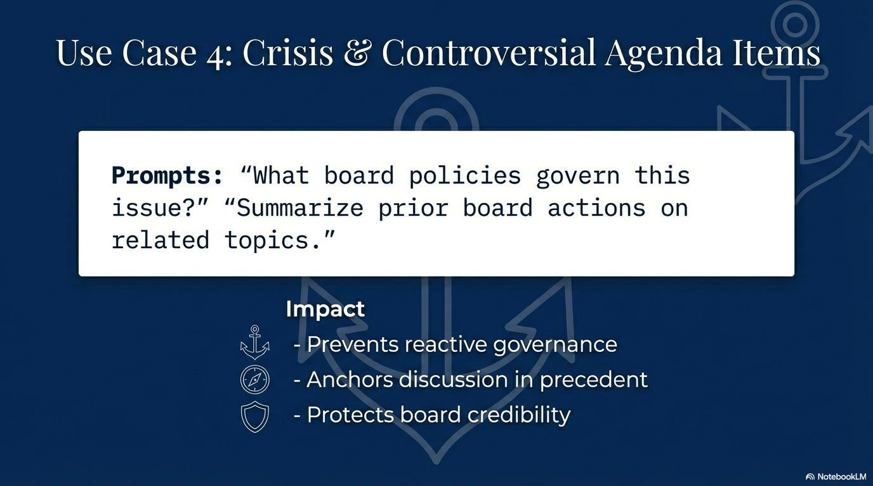
Notes:
In high-pressure moments, speed matters.
Trustees can ask:
“What board policies govern this issue?”
“What prior board actions relate to this topic?”
That preserves consistency.
It prevents reactive governance.
And it protects board credibility.

Slide 11
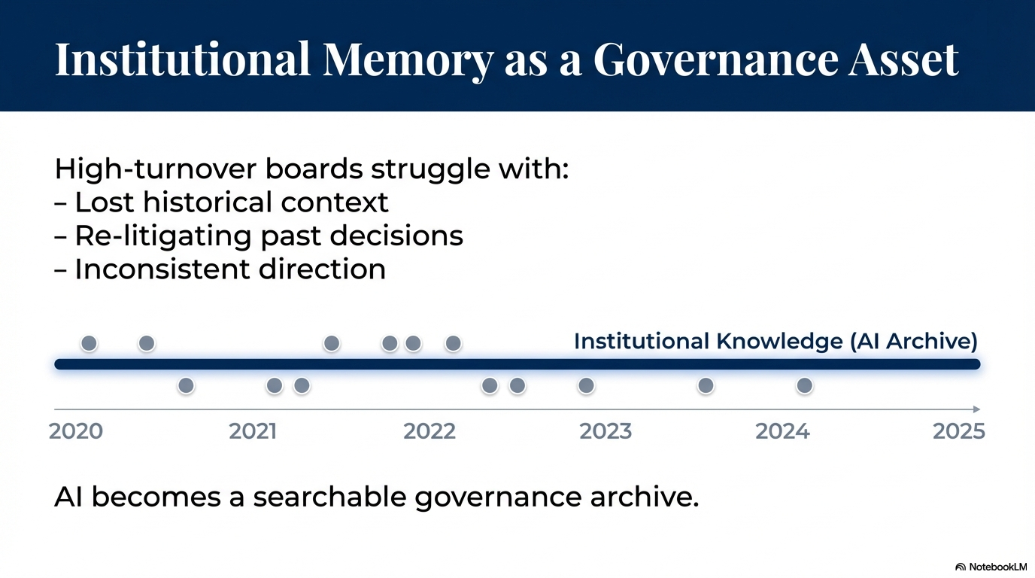
Notes:
High turnover is common.
New trustees often lack historical context.
AI-supported systems preserve institutional memory.
Instead of re-litigating settled issues, boards can quickly review precedent.
This improves continuity and strategic stability.

Slide 12
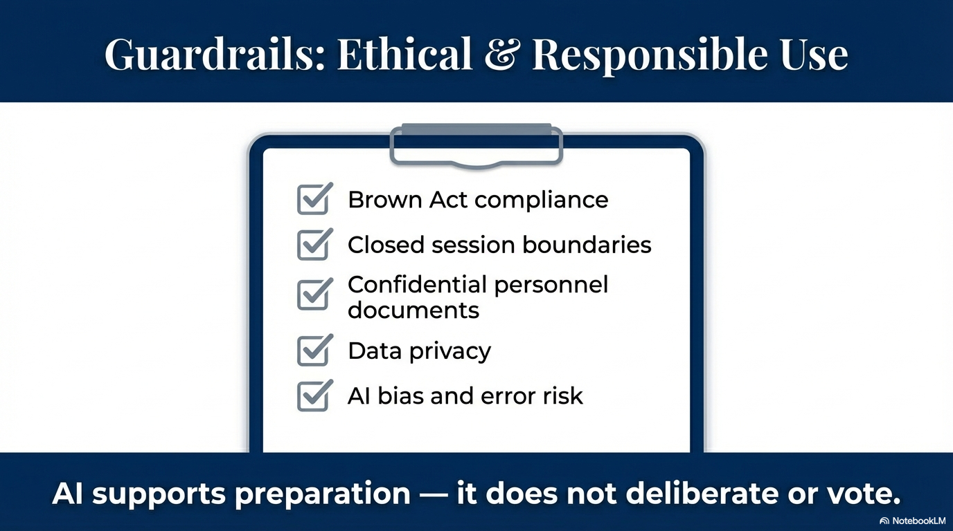
Notes:
This is critical.
Responsible use requires:
Brown Act compliance.
Closed session boundaries.
Protection of confidential documents.
Human verification of outputs.
Clear board protocol.
AI supports preparation.
It does not deliberate.
Elected trustees retain full authority and responsibility.
Always.

Slide 13
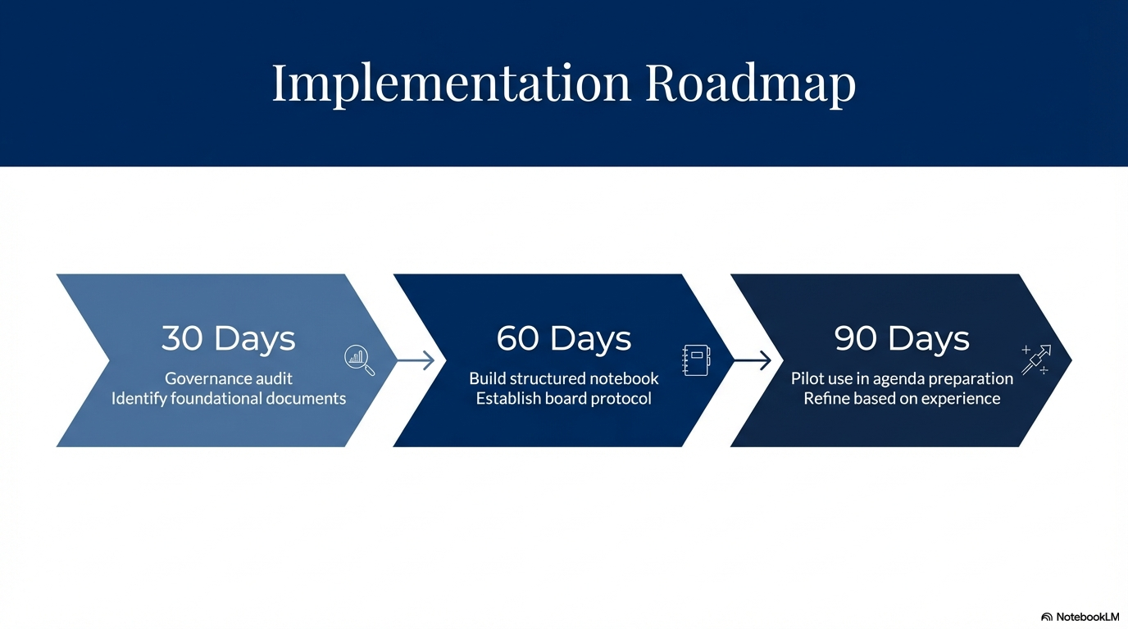
Notes:
Implementation should be disciplined and phased.
First 30 days:
Audit foundational documents.
Next 60 days:
Structure the governance notebook.
Develop board use protocol.
By 90 days:
Pilot use in agenda preparation.
Start small.
Refine intentionally.
This is governance evolution — not disruption.

Slide 14
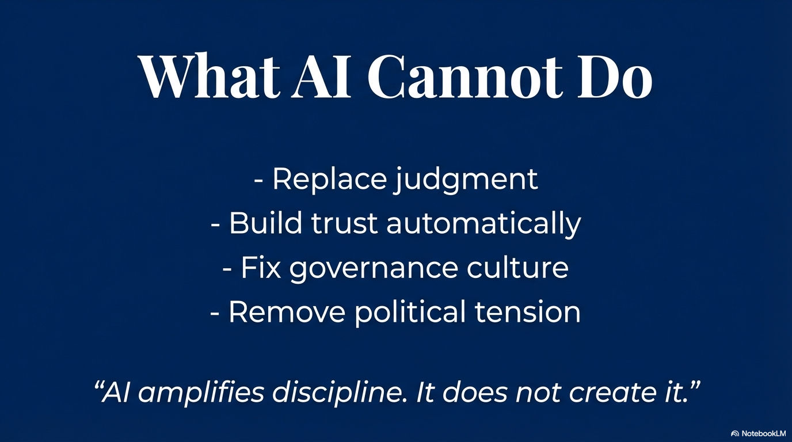
Notes:
AI cannot replace judgment.
It cannot fix governance culture.
It cannot eliminate political tension.
It cannot create trust automatically.
It amplifies discipline.
It does not create it.
The strength of the board still determines the outcome.

Slide 15
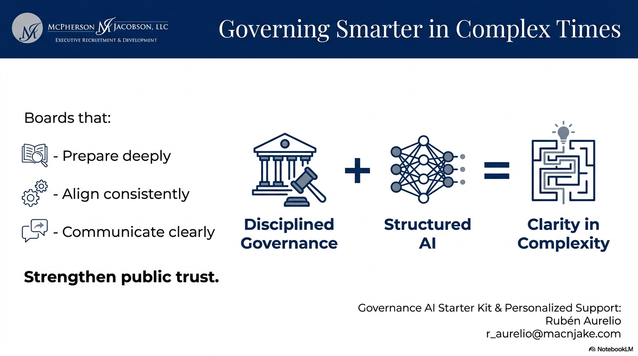
Notes:
In complex times, clarity matters.
Boards that prepare deeply…
Align consistently…
Communicate clearly…
Strengthen public trust.
Disciplined governance combined with structured AI creates clarity in complexity.
Thank you for your leadership — and I look forward to your questions.

